Slide 1
Air Permit Application DNREC Public Hearing November 20, 2018
WALAN Specialty Construction Products, LLC

Slide 2
Project Summary
Application status
History of application
Project provides ground granulated blast furnace slag (GGBFS)
Location (Port of Wilmington, Interstate, railroad, regional market, workforce)
GGBFS in demand
Currently no local source of GGBFS
Appropriate Zoning
1/3 mile to nearest residence
Minor air emissions source
Minimal risk -- Emissions comply with health based regulatory standards
Best available control technology (BACT)
No chemical additives
Newest equipment in industry
WALAN has 30 years of mineral grinding expertise
Value for Delaware – lower end user costs, tax base, local jobs, supports local businesses, Port

Slide 3
Location: 501 Christina Avenue in Wilmington, DE

Slide 4
Wilmington Location
Properly zoned - Waterfront Manufacturing W-1
Purpose. The W-1 waterfront manufacturing district provides areas where manufacturing and heavy industrial uses are well established and where there are suitable sites for such uses served by rail, water and highway networks. (Sec. 48-336.-W-1 district)
Surrounding parcels zoned for Waterfront Manufacturing and Light Manufacturing
Proximity to Port of Wilmington
Access to Interstate and rail
Access to trainable workforce
Regional market for material

Slide 5
Ground Granulated Blast Furnace Slag (GGBFS) is:
A portland cement substitute in concrete
Increases strength and durability of concrete
Odorless
Being required in regional DOT funded projects and private construction
WALAN’s process grinds granulated blast furnace slag from sand–like grains to powder

Slide 6
THE PROCESS – GBFS TO GGBFS

Slide 7
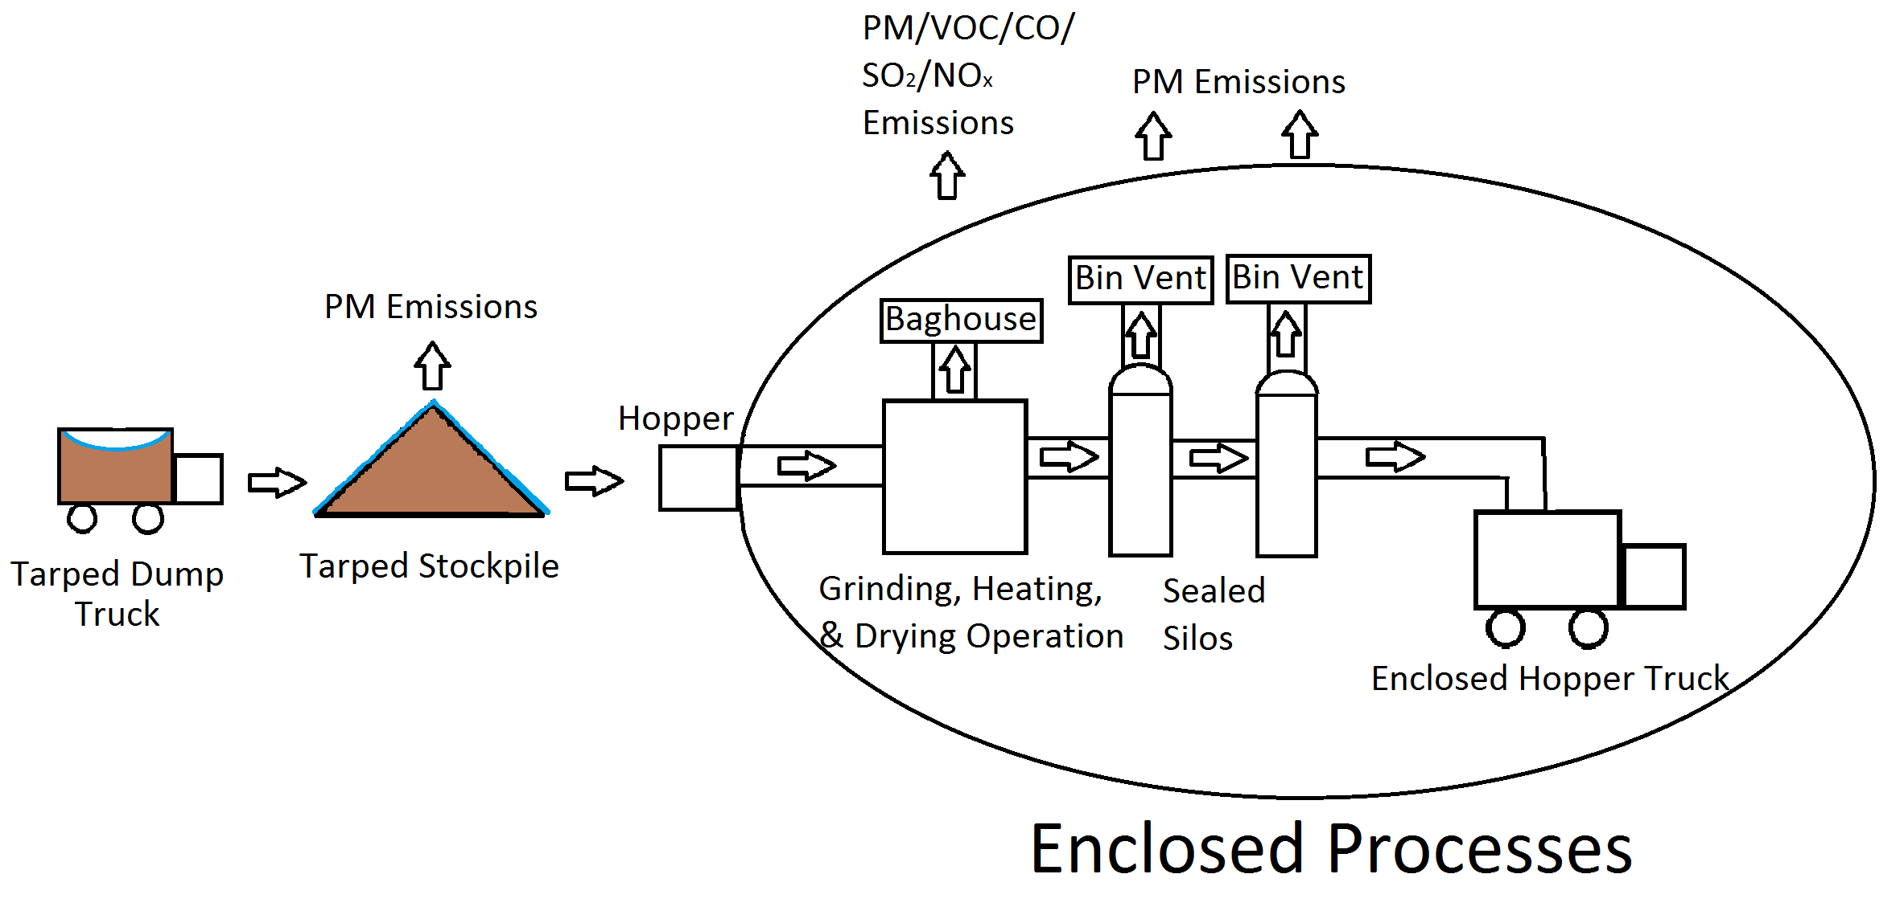
Overview of our Process
Ground Granulated Blast Furnace Slag (GGBFS) Grinding Facility

Slide 8
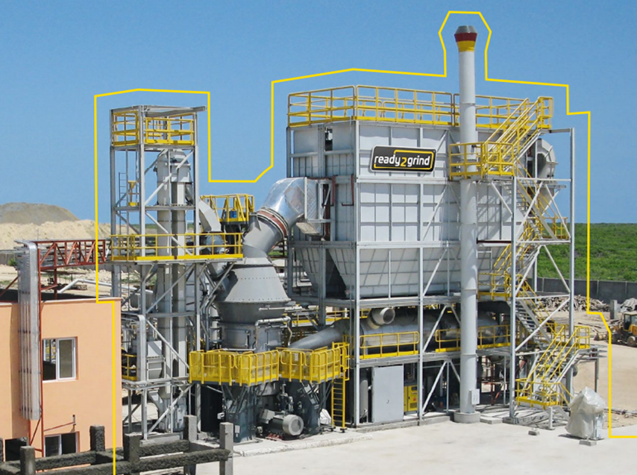
The Grinding Operation
New Gebr. Pfeiffer Vertical Roller Mill, modular system

Slide 9
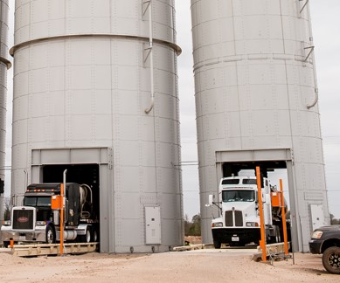
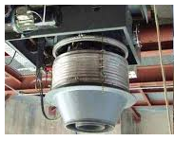
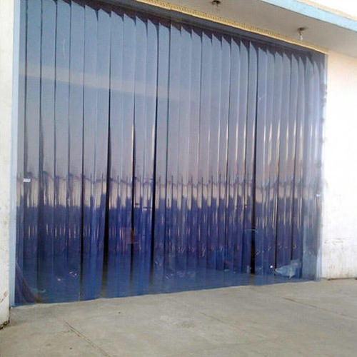
Product Storage Silos
After grinding, our finished product GGBFS will be stored in sealed silos with dustless loading spout
Source: https://www.indiamart.com

Slide 10
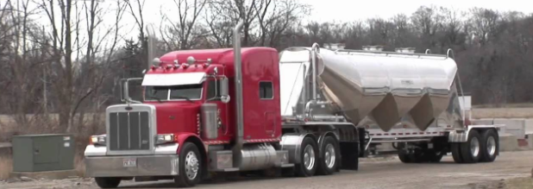
Finished Product Transport
Enclosed bulk tanker trucks with sealed hatches will carry GGBFS, our finished product, out of the plant

Slide 11
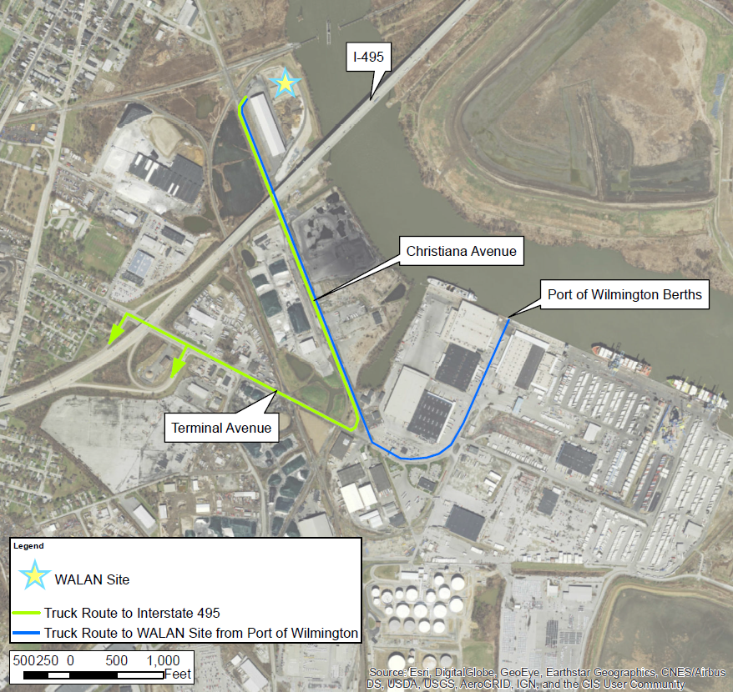
Local Truck Routes to Port, Interstate

Slide 12
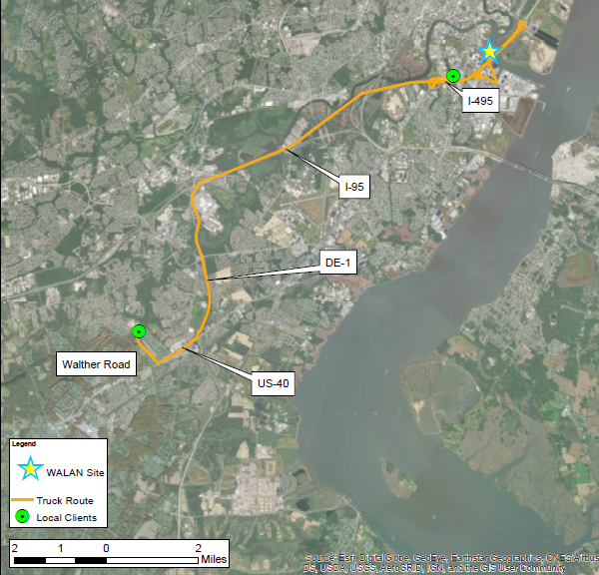
Route to Local Clients

Slide 13
Projected Air Emissions
Pollutant | Maximum Controlled Emission Rate (lbs/hour) | Projected Annual Air Emissions (tons/year) | New Castle County Major Source Thresholds (tons/year)
Particulate Matter (PM) | 1.318 | 5.776 | --
PM10 | 1.037 | 4.543 | 100
PM2.5 | 0.366 | 1.591 | 100
Sulfur Oxides (SOx) | 0.004 | 0.019 | 100
Nitrogen Oxides (NOx) | 0.724 | 3.171 | 25
Carbon Monoxide (CO) | 0.608 | 2.664 | 100
Total Volatile Organic Compounds (VOCs) | 0.040 | 0.174 | 25
Identified as natural minor source of emissions by DNREC

Slide 14
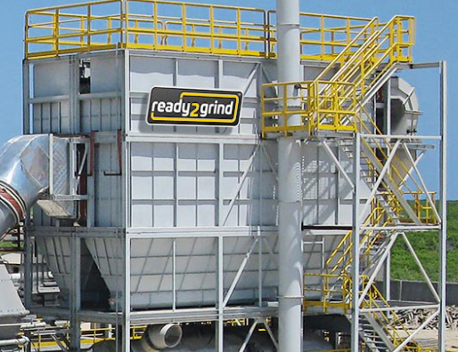
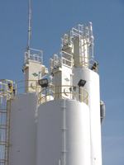
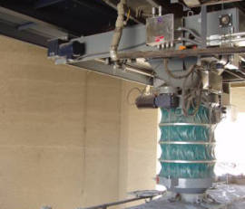
Emission Controls
Best Available Control Technology (BACT)
Baghouses and bin vents to capture particulate matter from grinding mill and silos
Dustless load from silos to trucks
Best Management Practices:
Maintaining moisture content of material
Stockpile tarping
Delivery truck beds entering facility will be covered
Trucks on paved surfaces
Pavement sweeping
Speed limits
Curtained truck entrances/exits beneath silos
Daily facility inspection and maintenance
Regular inspection/maintenance of equipment
Employee training
Daily record keeping

Slide 15
Emissions Comparison with National Health Standards
Pollutant | Predicted Pollutant Concentration (μg/m3) ⁽¹⁾ | Wilmington MLK 2016 Air Quality Monitoring Results (μg/m3) ⁽²⁾ | Combined Total Concentration (μg/m3) ⁽³⁾ | National Ambient Air Quality Standards (μg/m3) ⁽⁴⁾
PM10 | 6.61 | 14.2 | 20.81 | 150
PM2.5 | 1.96 | 9.2 | 11.16 | 12
NOx | 1.33 | 22.56 | 23.89 | 188
SOx | 0.0073 | 13.1 | 13.11 | 196.5
CO | 1.11 | 1832 | 1,833.11 | 10,000
Total substance concentrations in micrograms per cubic meter (μg/m3) were calculated using the Screen3 dispersion modeling program. Models were created for each emissions stack.
(2) Air quality results published by DNREC in 2016 for the Wilmington MLK monitoring station.
(3) The maximum 1‐hour concentrations from the models added to the Wilmington MLK air quality monitoring station results from 2016 gives an approximate combined air quality for comparison.
(4) The Environmental Protection Agency publishes the National Ambient Air Quality Standards (NAAQS). The primary standards consider the health of sensitive receivers (asthmatics, elderly, children, etc.)

Slide 16
Proximity of Site to Residential Areas

Slide 17
Photo 1 - View of Site from I-495 Bridge

Slide 18
Photo 2 - View of Site from Christina Avenue

Slide 19
Photo 3 - View from Site Toward Southbridge and Hicks Park

Slide 20
Photo 4 – Opposite Side of Christina Avenue

Slide 21
Photo 5 - View from Hicks Park

Slide 22
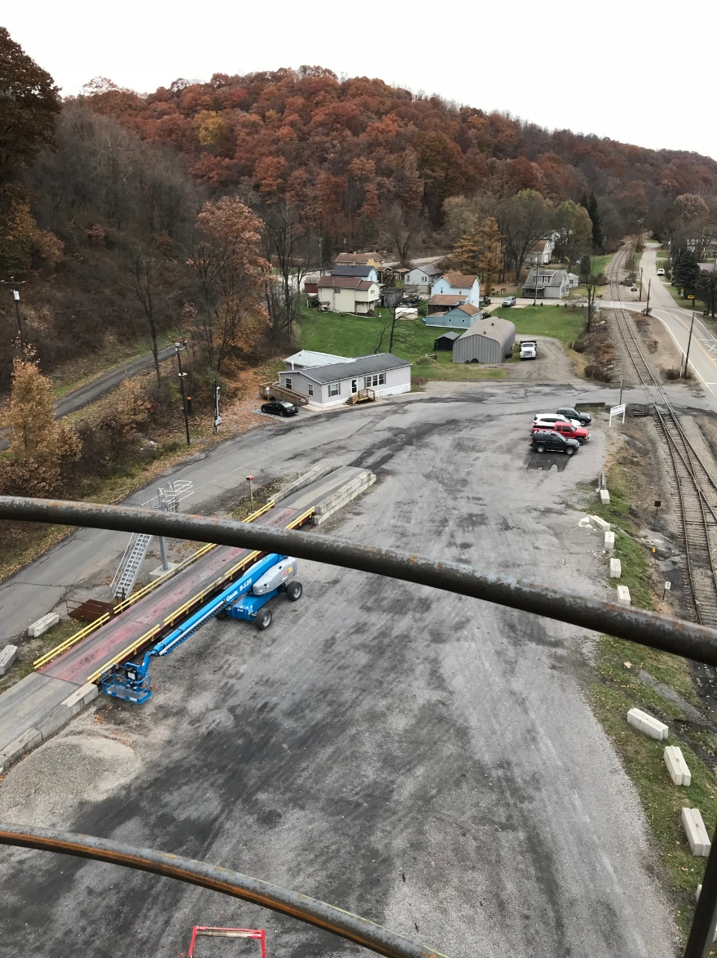
Company background
For over 30 years, a corporate affiliate of WALAN has been in the mineral grinding business
Iron ore grinding plant in Adrian, PA, servicing clients across the globe since 1982
Iron chromite grinding plant in Claysburg, PA, operating since 1987
Performance with consideration for the health and safety of employees, partners, neighbors, and customers
Goals for the future in Wilmington
Serve DE and regional market with sustainable, alternative material for construction
Reduce costs for local business and construction projects
Utilize transportation infrastructure
Employ qualified local residents
Be a good steward and neighbor as done in Pennsylvania

Slide 23
Community engagement
Company heard questions/concerns at previous public hearing
Engaged local stakeholders -- civic leaders and organizations, elected officials, business interests
Goals were to share information about project, answer questions, address concerns
Attended:
Oakmont Civic Association Meeting
Route 9 Corridor All Civic Associations Meeting

Slide 24
Response to community concerns
Modified truck routes to eliminate traffic through residential areas
Added tarp coverage of stockpiled material to dust control plan
Conducted cumulative impacts analysis to assess potential impact on community from air emissions
Bring practice of community support to DE that has been part of affiliate company culture in PA

Slide 25
Thank you

