Slide 1
Multi-family Program Potential in Delaware
Delaware Energy Efficiency Advisory Council

Slide 2
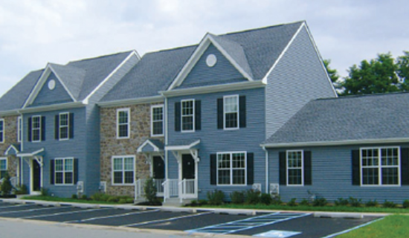
Intro to Multi-family Programs
Opportunities
Available potential
Key customer segment
Key Challenges
Split incentives
High level of engagement required

Slide 3
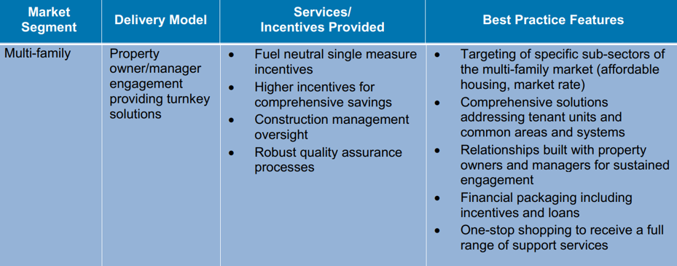
Program Concept

