Slide 1
Low-Global Warming Potential Refrigerants Program

Slide 2
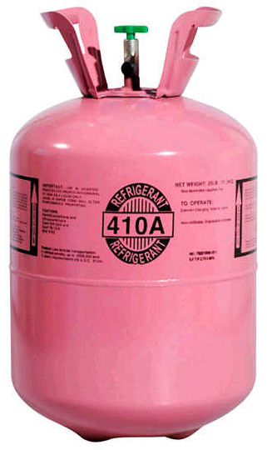
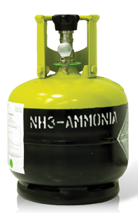
Refrigerants and Environmental Impact
Refrigerant systems use manufactured chemicals designed to efficiently move heat
In the 1980s, it was discovered that some of these chemicals severely damage the ozone layer
So, they were banned by international treaty
(1987 Montreal Protocol)
It has more recently been discovered that some of the new, replacement chemicals contribute a considerable amount to global warming per pound of emissions. For example:
This program’s goal is to recognize this fact, and incentivize use of refrigerant chemicals that that have less Global Warming Potential (GWP) impact.
1 pound of R410A = 2088 lbs.
of carbon dioxide
1 pound of Ammonia = 0
Global Warming Potential (GWP)

Slide 3
An Industry-Leading Opportunity for Delaware
Global warming impacts from refrigerants have received limited attention in U.S. federal and state policy up to now
We were only able to find municipal-level programs, such as the Sacramento Municipal Utility District (SMUD) program
Delaware could be a national leader in this area
To pursue this opportunity, more on-the-ground experience is needed, so we can evaluate it and incorporate into our analysis

Slide 4
By the Numbers: Delaware Low-GWP Program

Slide 5
Next Steps for Establishing a DE GWP Program
Set Program Incentives
Engage with Delaware Workforce
Delaware Market Research
Verify Leak Rates
e.g. require monitoring equipment if incentive received

Slide 6
Set Program Incentives
Set Program Incentives
Finalize list of eligible low GWP refrigerants
Set payment per ton-CO2 equivalent avoided & incentive caps

Slide 7
Set Program Incentives
Project Incentive Cap
Incentive per ton avoided CO2-e
Total $ vs. % of project cost
We suggest starting with a total $ cap only, of $100,000.
With the $680,000 budget based on our analysis, the program can provide incentives to at minimum ~7 projects
If popular, adding a secondary cap requiring matching funds makes sense
Our analysis so far has assumed $25/tCO2e, based on the SMUD program
We believe this is a good starting point, and the program should be launched using this incentive level
If program uptake starts off slow, this figure can be raised
An ‘aggressive’ incentive, $100/tCO2e, is the value used in RI cost-benefit tests.
Re-assess every 3-6 months in first two program years, and then annually

Slide 8
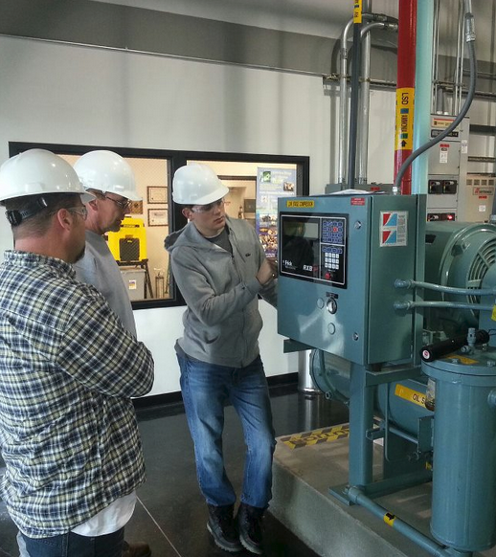
Engage with Workforce
Engage with Workforce
Understand familiarity with low-GWP refrigerant systems
Determine level of workforce training needed

Slide 9
Engage with Workforce
Low-GWP refrigerant familiarity
Training & Outreach Plan
April – develop interview guide for workforce research
May – phone-based outreach to 10-20 refrigeration system servicing firms
June – synthesize findings into a perspective on level of familiarity, and level of comfort installing low-GWP systems
July – If needed, allocate $100,000 from program year 1 budget to training & outreach. Develop training material.
August – Finish development of training materials, make them available online
September + beyond – Provide quarterly training webinar/seminar with outreach to industry groups to drive awareness

Slide 10
Delaware Market Research
Quantify current refrigerant mix in use in Delaware
Assess level of interest in low-GWP refrigerant incentives

Slide 11
Delaware Market Research
Large Firm Outreach
Survey for Interest
April – Build list of largest refrigerant systems in DE (~10-25 total)
May – Directly contact each facility to understand current refrigerant system and, if not already low-GWP, interest level in
June – Synthesize findings, adjust estimate of annual program throughput & budget if needed
April/May – Develop online/phone survey to gather information from small businesses about refrigeration systems (current and low-GWP interest)
June/July – Use this survey instrument to gather a statistically significant sample of refrigerant systems and owners’ interests in low-GWP alternatives

Slide 12
Refrigerant System Retrofit Costs Model
One area with limited information is the full costs of retrofitting to low-GWP refrigerants
Many potential customers will also lack this information
DNREC can help remove this barrier by gathering information from manufacturers, contractors, and other geographies where these systems are more common

Slide 13
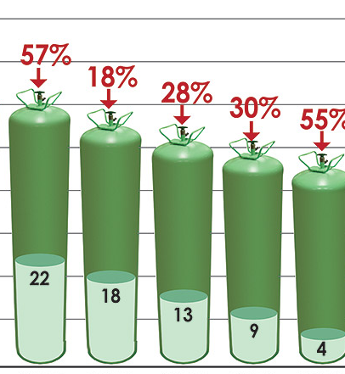
Verify Leak Rates
Program will initially launch using deemed savings based on past refrigerant recharge purchases, and low-GWP leak data from manufacturers
Once systems that received incentive $$ come online: Tracking actual system leak rates can be used to refine deemed savings algorithm, or to begin paying incentives based on actual leakage

Slide 14
Delaware 2019 HFC Program Development Schedule
Develop interview guide for workforce research
Phone-based outreach to 10-20 refrigeration system servicing firms
Synthesize findings into a perspective on level of familiarity, and level of comfort installing low-GWP systems
If needed, allocate $100,000 from program year 1 budget to training & outreach. Develop training material.
Finish development of training materials, make them available online
Program Start
Directly contact each facility to understand current refrigerant system and, if not already low-GWP, interest level in
Build list of largest refrigerant systems in DE (~10-25 total)
Provide quarterly training webinar/seminar with outreach to industry groups to drive awareness
Synthesize findings, adjust estimate of annual program throughput & budget if needed
Develop online/phone survey to gather information from small businesses about refrigeration systems (current and low-GWP interest)
Use survey instrument to gather a statistically significant sample of refrigerant systems and owners’ interests in low-GWP alternatives
May
Jun
Jul
Aug
Gather further information about market potential, customer and contractor interest and awareness, typical installation costs
Update estimated funding need, program potential
Allocate funding to training and outreach, if needed
Launch Program
Provide Training Materials and Sessions
Create Mgmt. plan for beyond 2019

Slide 15
Questions?

