Slide 1
DNREC Energy Efficiency Programs
Ed Synoski
January 16, 2019
861 Silver Lake Blvd., Dover, DE

Slide 2
2018 Programs
EEIF – Energy Efficiency Investment Fund
E2I – Energy Efficiency Industrial
WAP – Weatherization Assistance Program

Slide 3
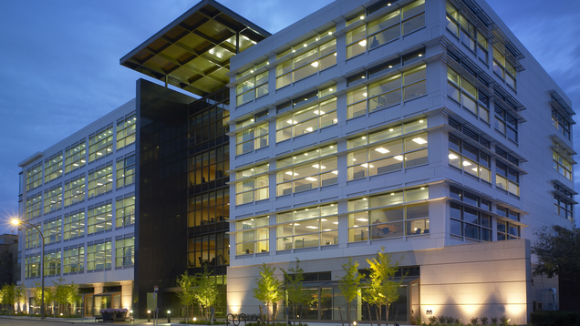
Energy Efficiency Investment Fund (EEIF)
About
Supports commercial and industrial customers replace aging, inefficient equipment and systems with energy efficient alternatives.
2018 Highlight
First Combined Heat and Power (CHP) application was pre-approved
Looking Forward
Comprehensive review of program incentive levels

Slide 4
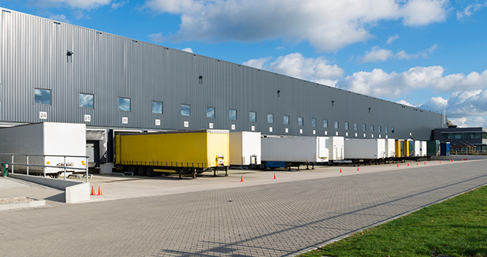
Energy Efficiency Industrial (E2I)
About
Helps large-scale energy users make their operations more energy efficient through innovative upgrades.
Looking Forward
Seeking new applicants

Slide 5
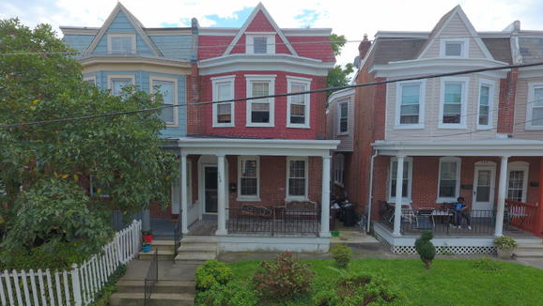
Weatherization Assistance Program (WAP)
About
Helps income eligible homeowners and renters cut their energy bills by weatherproofing and improving the energy efficiency of their homes.
2018 Highlights
Contracted a new sub-grantee:
Energy Coordinating Agency (ECA)
Hired a new State Monitor
Increased outreach and marketing efforts
Looking Forward
Meeting the State goal to weatherize 400 households
Starting a low-income solar program before April 1, 2019

